Slide 1
Solubility
Term 2 Weeks 1-2

Slide 2
Chromatography
Stationary vs Mobile phases
Separation of mixtures using differential polarities
Techniques:
Paper chromatography
Thin Layer Chromatography (TLC)
Gas Chromatography (GC)
High Performance Liquid Chromatography (HPLC)

Slide 3
Chromatography
Solute dissolves in solvent
Chemicals will adsorb to a surface (stationary phase) and desorb into a solvent (mobile phase) at different rates.
“Like dissolves Like”, “like likes like” – use for reference NOT for explanation

Slide 4
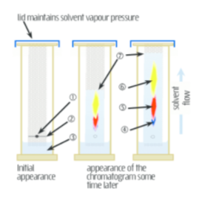
Paper and Thin Layer Chromatography (TLC)
Paper stationary phase is water bound to cellulose thus very polar.
TLC stationary phase is silica thus very polar.
Retention factor (Rf) = solute / solvent

Slide 5
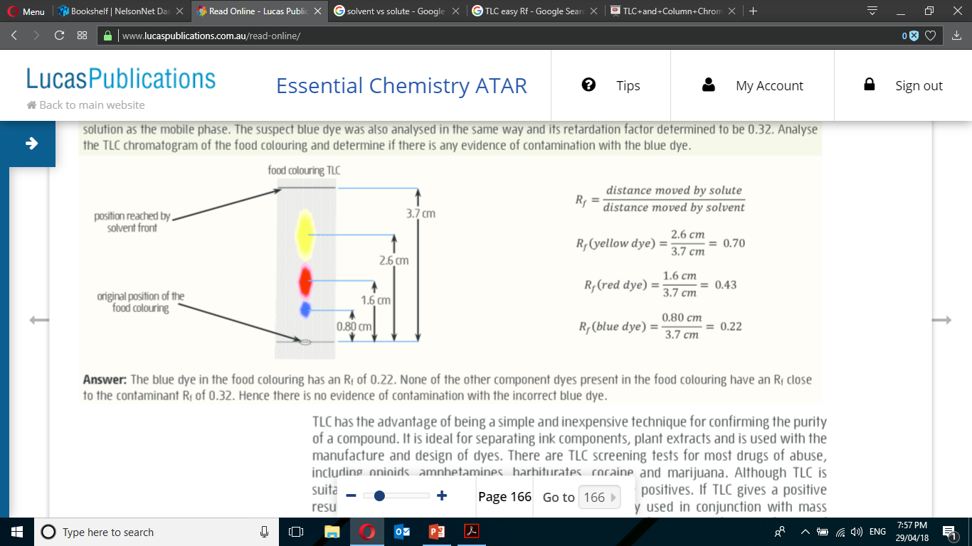

Slide 6
Calculating retention factor (Rf)

Slide 7
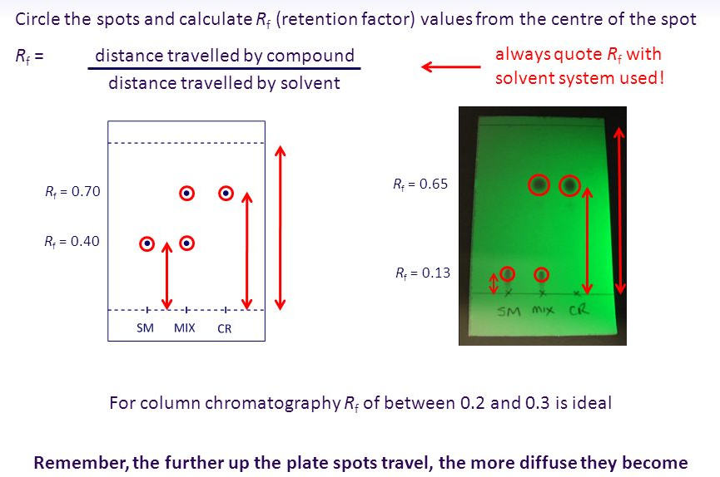

Slide 8
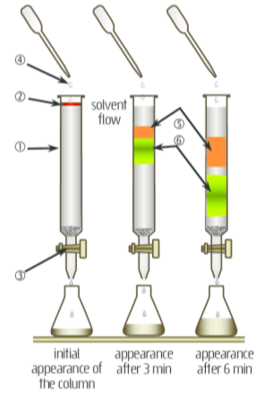
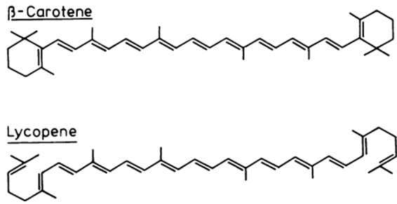
Column chromatography
Stationary phase of silica gel (SiO₂) or Alumina (Al₂O₃) – polar
Separate components which retain to the stationary phase differently
Gravity moves solvent downwards.
Eg.

Slide 9
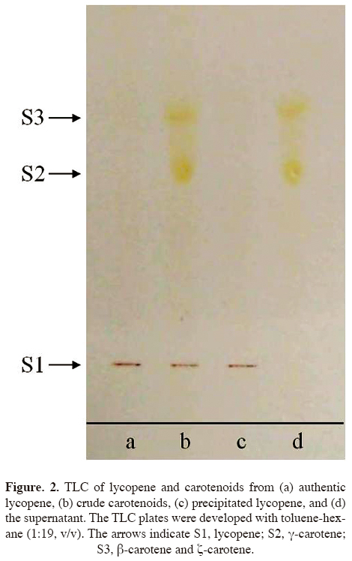

Slide 10
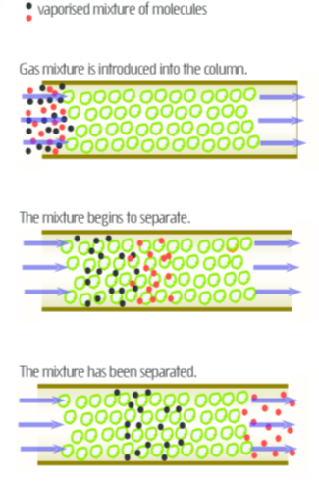
Gas Chromatography (GC)
Identify concentrations in complex mixtures
Mobile phase is an inert carrier gas (He, N₂)
Stationary phase – viscous liquid coated on silica (SiO₂)
Stationary phase particles packed into a small column (2-5 mm width, 1.5-10 m long)
Compounds are retained based on volatility.

Slide 11
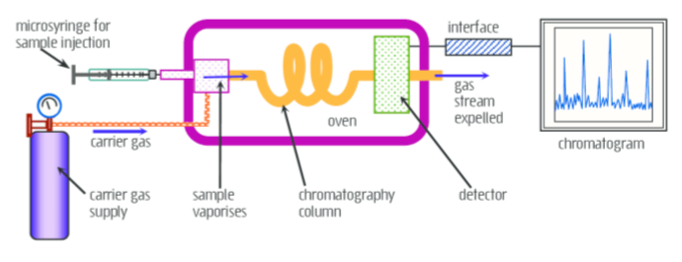
GC
High volatility (weak intermolecular forces) are eluted first as they prefer the mobile phase.

Slide 12
High Performance Liquid Chromatography (HPLC)
GC can be used for low boiling point mixtures but not high boiling point/ temperature sensitive. Compounds with a molecular weight greater than 300 g mol⁻¹ cannot typically be analysed.
Stationary phase – SiO₂ packing in column 3-5 mm width, 10-30 cm length. POLAR
Mobile phase – non-polar solvent
Retention based on polarity.

Slide 13
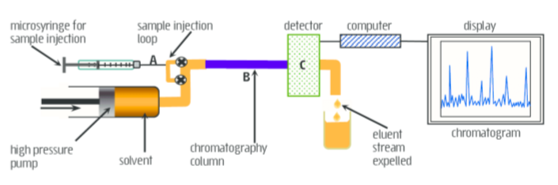
HPLC

Slide 14
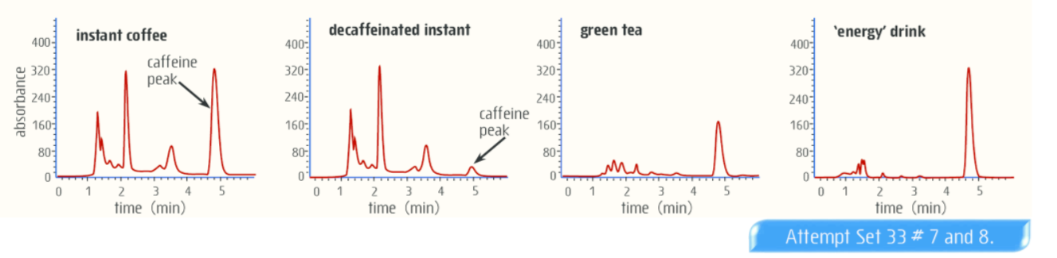
HPLC

